Slide 1
EE3IOT – Internet of Things
Lab 1: Introduction and tips
Dr. Richard Nock

Slide 2
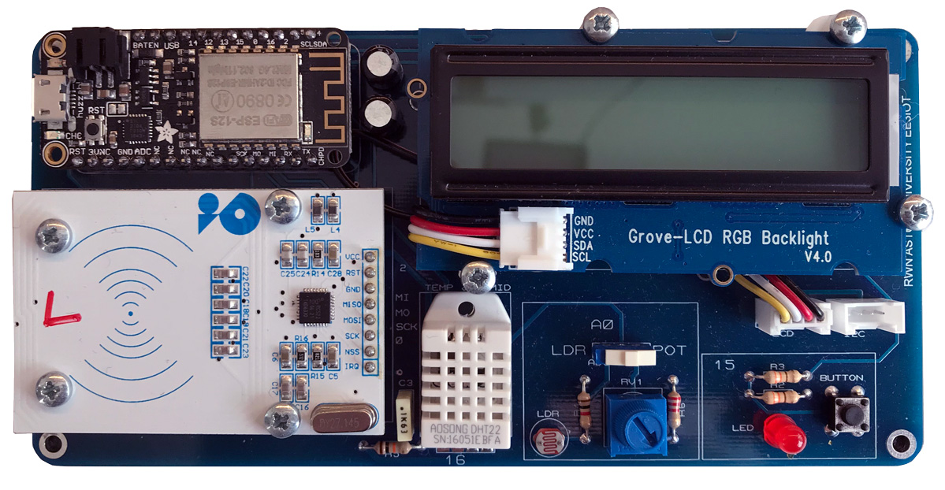
The hardware and the first laboratory
The first laboratory aims to introduce to the Arduino Integrated Development Environment (IDE) and the Aston IoT application trainer.
The board is capable of:
Temperature and humidity sensing via a DHT22.
Analogue input: from a LDR light sensing circuit or a potentiometer.
Reading and writing of Mifare RFID tags operating at 13.56 MHz.
Displaying alphanumeric characters on 16x2 character liquid crystal display (LCD) with a programmable RGB backlight.

Slide 3
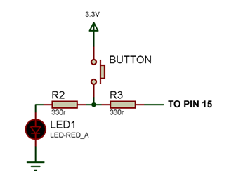
A note on the button and LED usage
Due to the limited number of IO pins on the ESP8266, the indicator LED and the push to make button share the same IO pin.
Note that pin 15 on the ESP8266 module has a pull down resistor.

Slide 4
Detecting a single button press – the problem with switch bounce
Pressed duration, typically 100-300 ms
Amplitude (Volts)
Time (Seconds)
Pressed bounce period,
typically < 5ms
Released bounce period,
typically < 5ms
If we detect rising edges in our software, we will detect multiple presses!

Slide 5
Demonstration on the oscilloscope

Slide 6
Demonstrating button bounce by reading buttons the WRONG way
Wait for the button to be pressed: Whilst the button is equal to 0, do nothing.
Wait for the button to be released: Wait for the button to be released
Do something

Slide 7
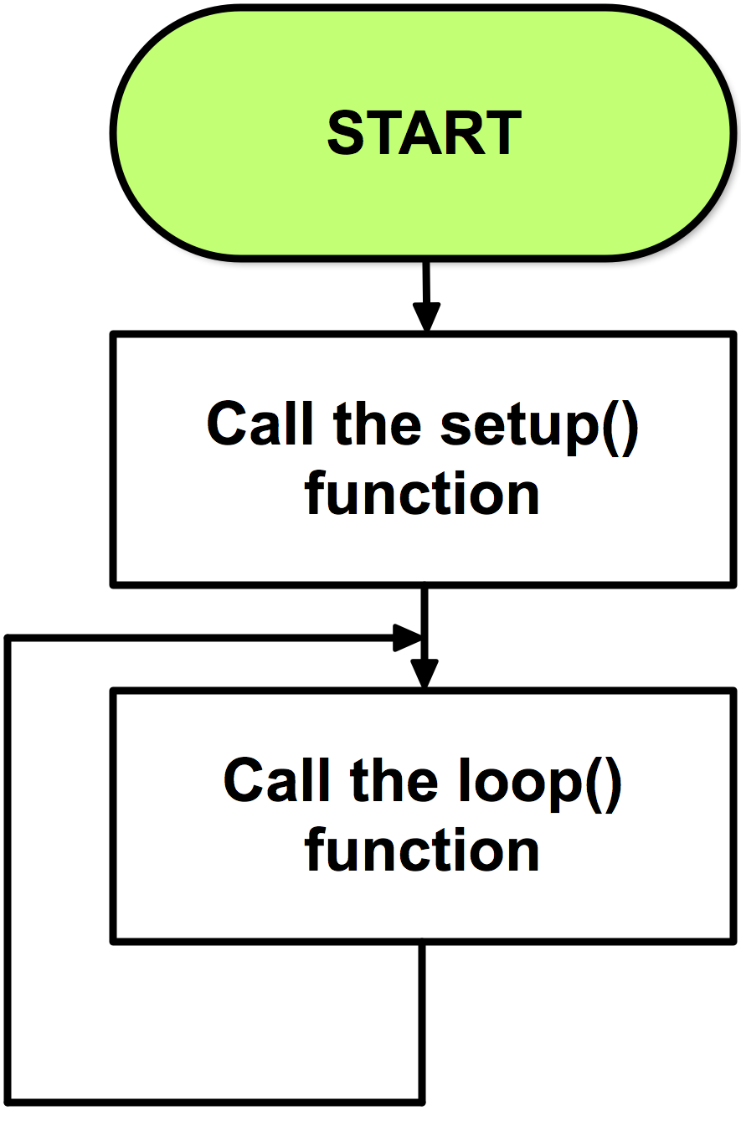
How this code is used
In the Arduino IDE, setup() and loop() are functions. Setup is called once on start up and loop() is then called continuously. Hence, we can write our own functions and call them in either the setup or loop functions.
Hence, we can place this bad code in the loop function. It will be continuously run until we reset the board or remove power.

Slide 8
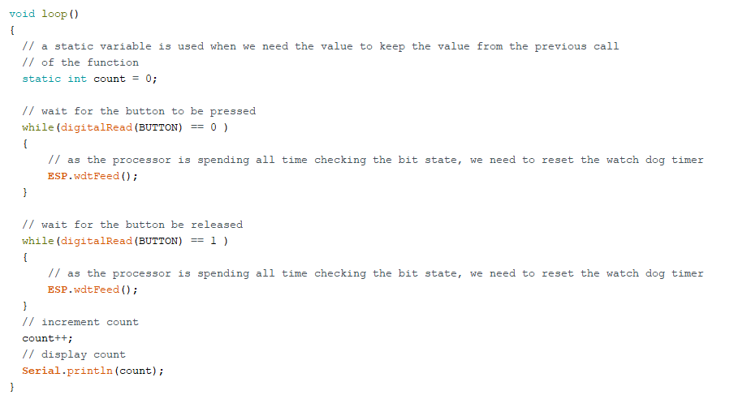
Reading buttons the WRONG way
Waiting for button to be pressed
Waiting for button to be released
Increment a counter and print it out

Slide 9
Demonstration on multiple counts

Slide 10
Problems
Consumes most of the CPUs time.
Will detect multiple edges due to switch bounce. This algorithm does nothing to mitigate switch bounce.
Hence, we need a solution which uses minimal CPU time and returns a positive value only when the button has been pressed.
We also have to consider that the LED is also connected to the switch.

Slide 11
Detecting a single button press – the problem with switch bounce
Pressed duration, typically 100-300 ms
Amplitude (Volts)
Time (Seconds)
Pressed bounce period,
typically < 5ms
Released bounce period,
typically < 5ms
Q. Any ideas on how we write software to use both the LED and the button?

Slide 12
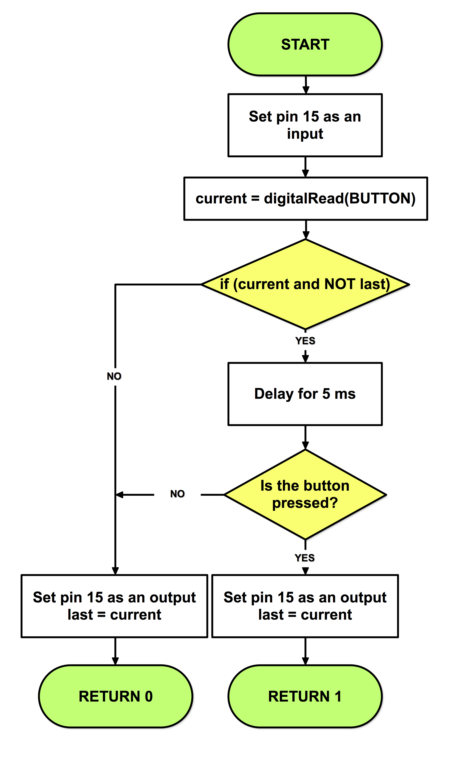
How to use the LED and the button
The LED can be used as normal. Setting the output pin high will result in the LED illuminating.
Using the button is a little more involved.
You will create a C function to implement the flow chart shown.
This will be periodically called and it will quickly turn pin 15 into an INPUT to check the button state.
It will return a 1 on the button being just being pressed and a 0 at all other times.

Slide 13
How to use the LED and the button
This will check to see if the button has been pressed (rising edge) and then check again after 5ms to account for switch bounce.
Two variables are needed in the function, current and last.
We store the last state of button such that we can detect a rising edge.
What must be special about these variables?

Slide 14
How to use the LED and the button
This part implements the rising edge detection.
This part accounts for bounce and if we are on the rising edge.

Slide 15
If you are unsure about the use of C functions, read Learning Resources | Support Material | C programming tips | C functions on Blackboard.
If you are still unsure, we can cover this in the laboratory session. However, please use your cameras/microphones if possible!

